Slide 1
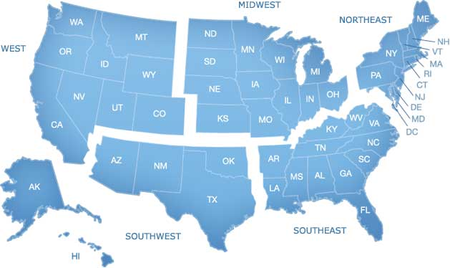
Regions of the United States
West Region
Notes:
1

Slide 2
West States and Capitals:
State | Capital
Alaska | Juneau
California | Sacramento
Colorado | Denver
Hawaii | Honolulu
Idaho | Boise
Montana | Helena
Nevada | Carson City
Oregon | Salem
Utah | Salt Lake City
Washington | Olympia
Wyoming | Cheyenne

Slide 3
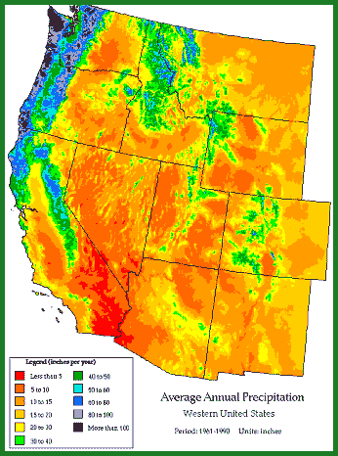
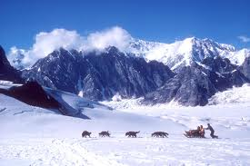
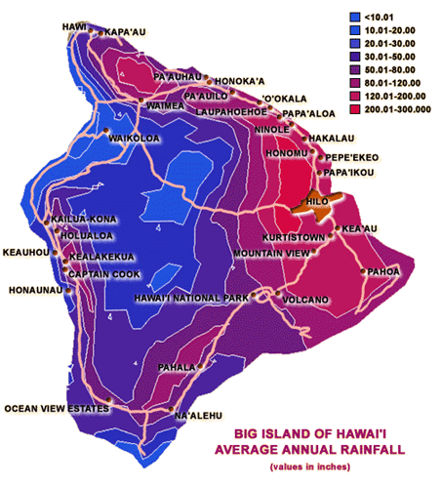
Climate of the West:
Desert, arid
Mostly dry & hot
Little rain
Hawaii: Tropical Wet
Hot and rainy
all year
Alaska: Subpolar
(short cool summer, long cool winter)

Slide 4
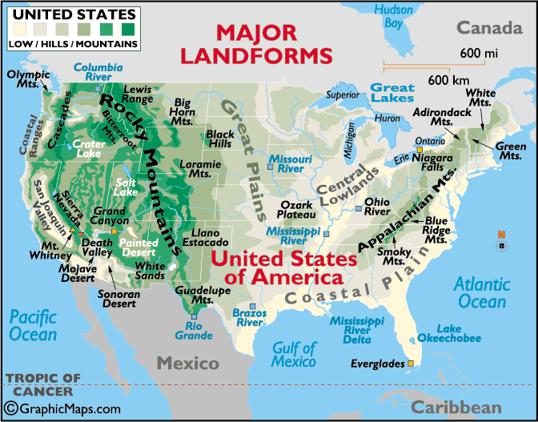
Major Landforms of West
-Many mountains and plateaus
-Rocky Mountains
-Grand Canyon

Slide 5
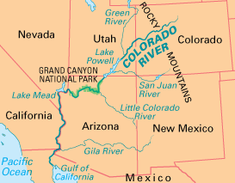
Major Bodies of Water
Pacific Ocean
Salt Lake
Colorado River

Slide 6
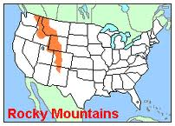
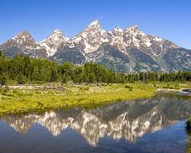
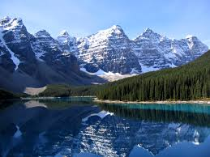
Major Mountains of West

Slide 7
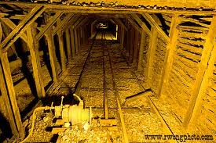
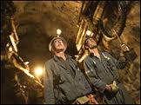
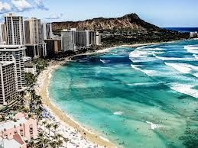
Major Industries
Tourism |  | Mining

Slide 8
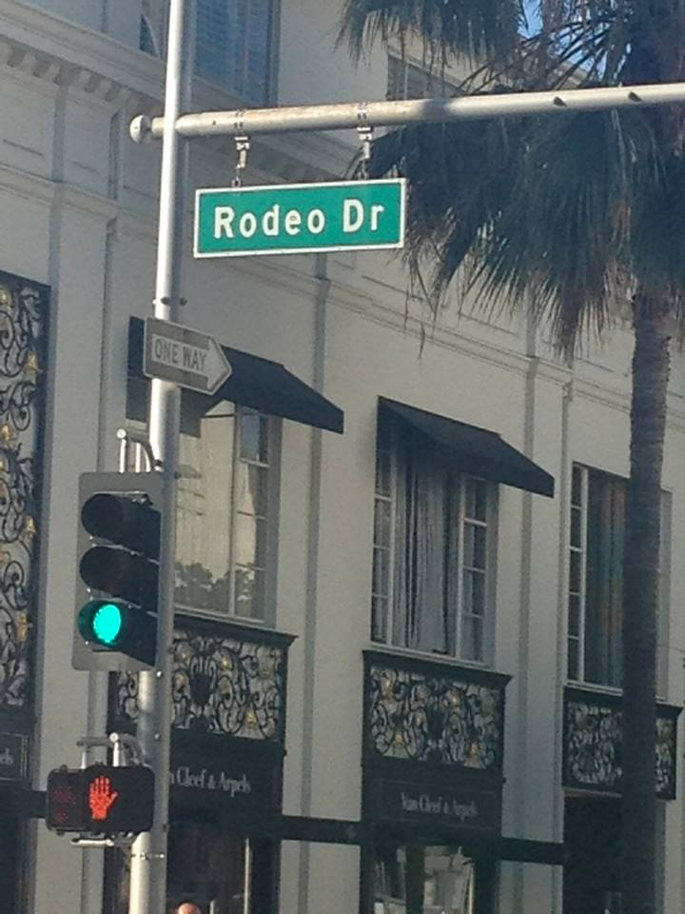
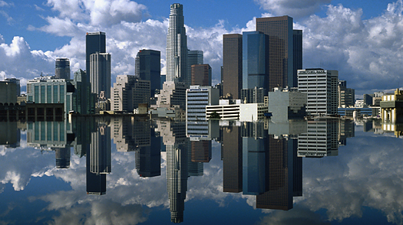
Los Angeles, California

Slide 9
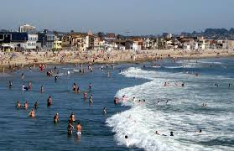
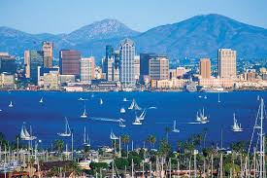
San Diego, California

Slide 10
San Francisco, California

Slide 11
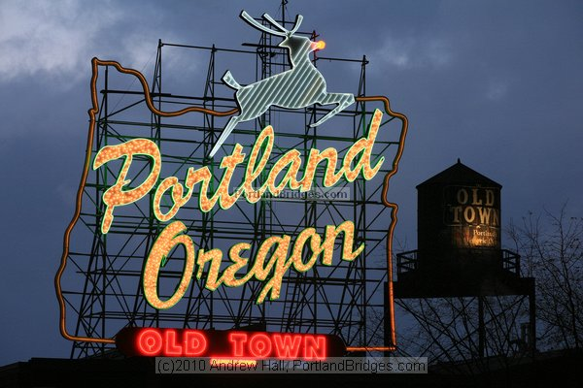
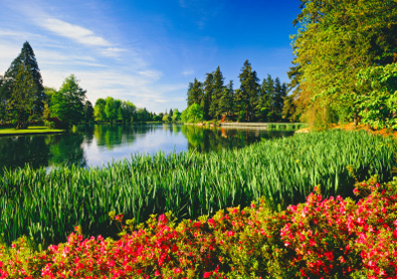
Portland, Oregon

Slide 12
Las Vegas, Nevada

Slide 13
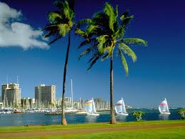
Honolulu, Hawaii

