Slide 1
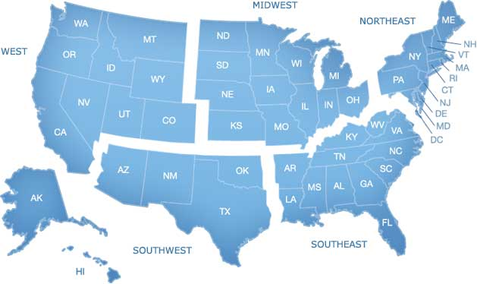
Regions of the United States
Southwest Region
Notes:
1

Slide 2
Southwest States and Capitals:
State | Capital
Texas | Austin
New Mexico | Santa Fe
Oklahoma | Oklahoma City
Arizona | Pheonix

Slide 3
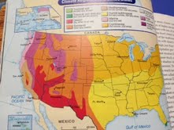
Climate of the Southwest:
Dry and hot for most of the year
Desert (very little rain)

Slide 4
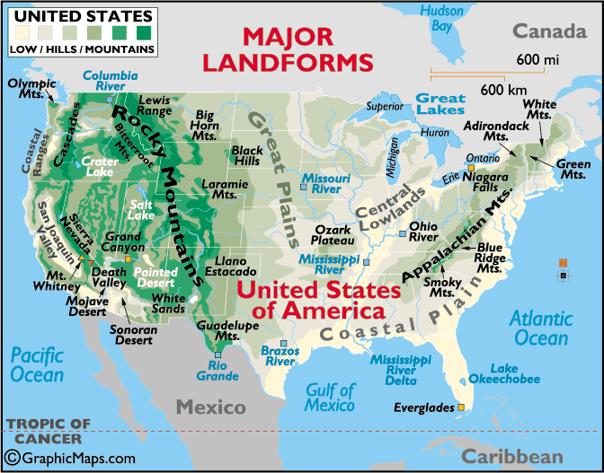
Major Landforms of Southwest
Plains and hills
More mountainous as you move West

Slide 5
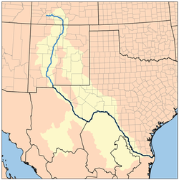
Major Bodies of Water
Gulf of Mexico
Rio Grande

Slide 6
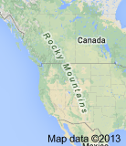
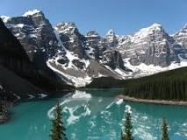
Major Mountains of Southwest
Rocky Mountains

Slide 7
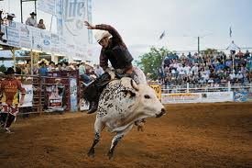
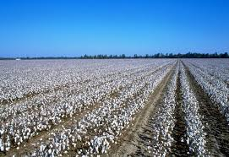
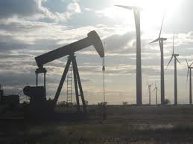
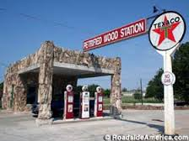
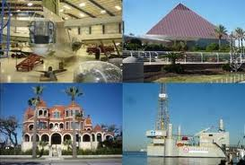
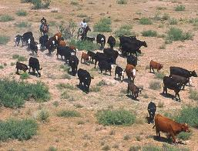
Major Industries
Tourism | Agriculture Cotton Livestock | Oil/Gas

Slide 8
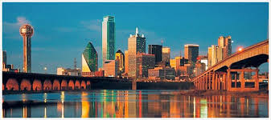
Dallas, Texas

Slide 9
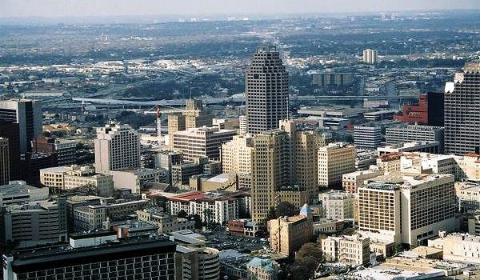
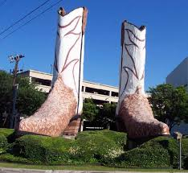
San Antonio, Texas

Slide 10
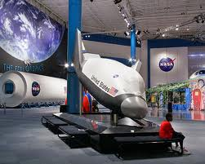
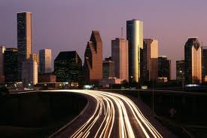
Houston, Texas

Slide 11
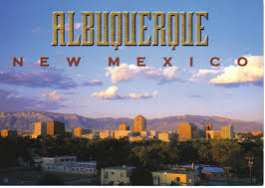
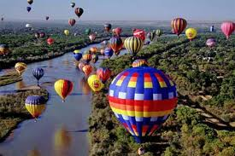
Albuquerque, New Mexico

