Slide 1
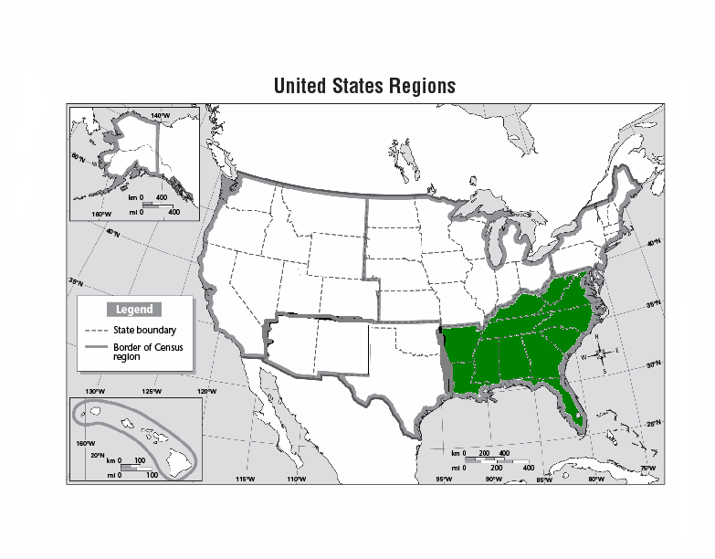
Regions of the United States
Southeast Region
Notes:
1

Slide 2
Southeast States and Capitals:
State | Capital
Alabama | Montgomery
Florida | Tallahassee
Georgia | Atlanta
Kentucky | Frankfort
Mississippi | Jackson
North Carolina | Raleigh
South Carolina | Columbia
Tennessee | Nashville
Virginia | Richmond
West Virginia | Charleston
Louisiana | Baton Rouge
Arkansas | Little Rock

Slide 3
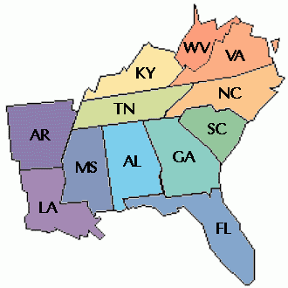

Slide 4
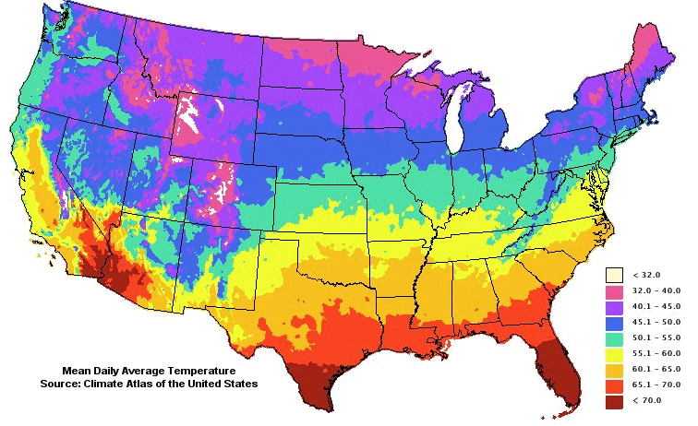
Climate of the Southeast:
Hot rainy summer, mild rainy winter
Good for farming and growing plants

Slide 5
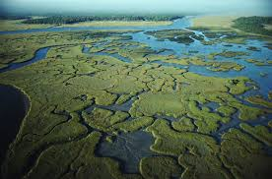
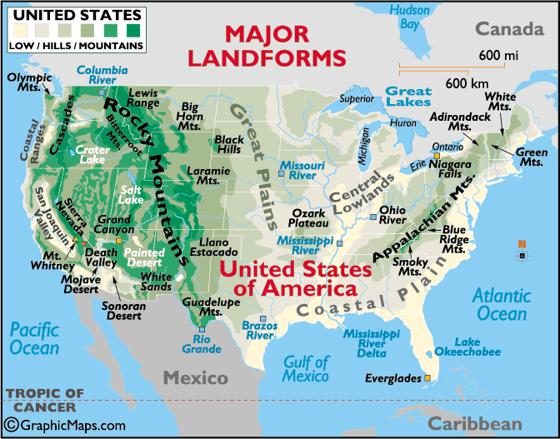
Major Landforms of Southeast
Coastal Plains
Wetlands
Marshes
Swamps
Everglades

Slide 6
Major Bodies of Water
Atlantic Ocean
Gulf of Mexico
Mississippi River

Slide 7
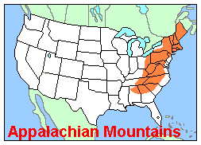
Major Mountains of Southeast
The Appalachian Mountains run through part of the Southeastern United States.

Slide 8
Major Industries
Tourism | Agriculture | Manufacturing

Slide 9
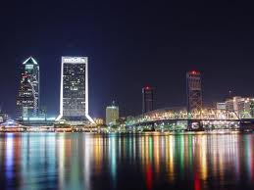
Jacksonville, Florida

Slide 10
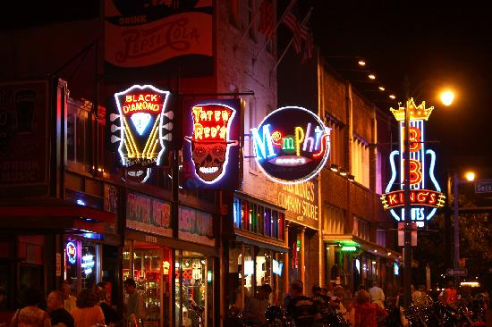
Memphis, Tennessee

Slide 11
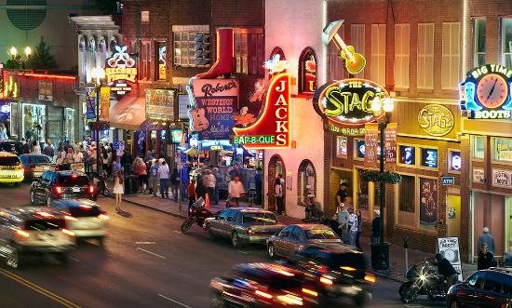
Nashville, Tennessee

Slide 12
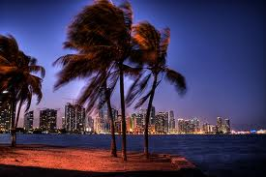
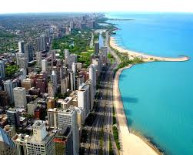
Miami, Florida

Slide 13
Atlanta, Georgia

