Slide 1
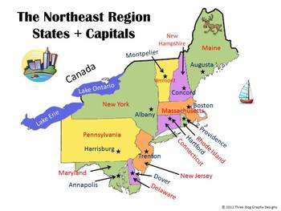
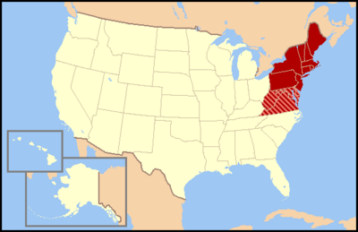
Regions of the United States
Northeast Region
Notes:
1

Slide 2
Northeast
Included States: Maine, New Hampshire, Vermont, Massachusetts, New York, Pennsylvania, Rhode Island, Connecticut, New Jersey, Maryland, Delaware.

Slide 3
Northeast States and Capitals:
State | Capital
Maine | Augusta
Rhode Island | Providence
New York | Albany
Pennsylvania | Harrisburg
Delaware | Dover
Maryland | Annapolis
Connecticut | Hartford
New Hampshire | Concord
New Jersey | Trenton
Massachusetts | Boston
Vermont | Montpelier

Slide 4
Climate of the Northeast:
Cold, snowy winters and hot summers.

Slide 5
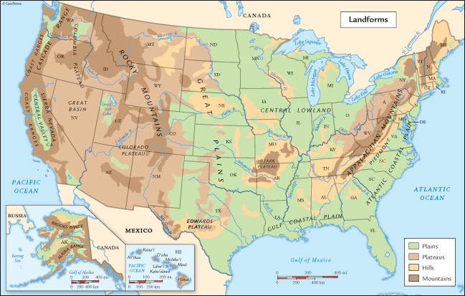
Major Landforms of Northeast
Many mountains and valleys

Slide 6
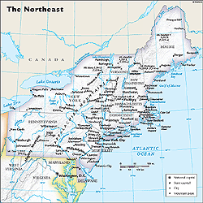
Major Bodies of Water
The North East is
SURROUNDED by
bodies of water:
Atlantic Ocean
Lake Ontario
Lake Erie
Hudson River
Connecticut River
St. Lawrence River

Slide 7
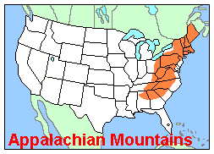
Major Mountains of Northeast
The Appalachian Mountains run through most of the North East Region.

Slide 8
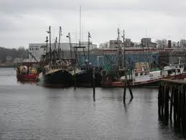
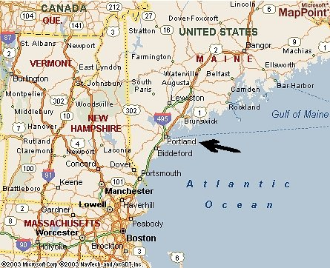
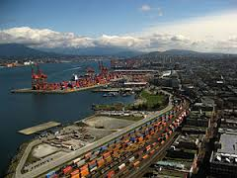
Major Industry: Shipping and fishing
Fishing/sea food
Shipping

Slide 9
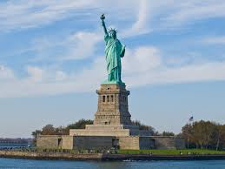
New York City, New York

Slide 10
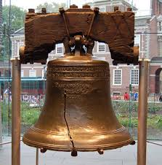
Philadelphia, Pennsylvania

Slide 11
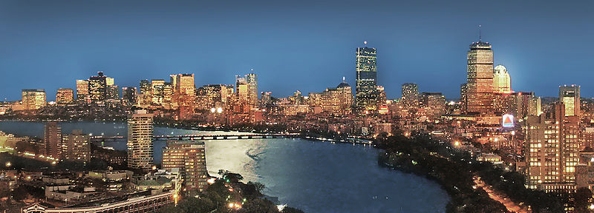
Boston, Massachusetts

Slide 12
Pittsburgh, Pennsylvania

