Slide 1
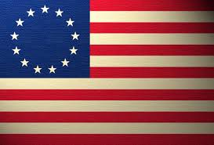
American Revolution

Slide 2
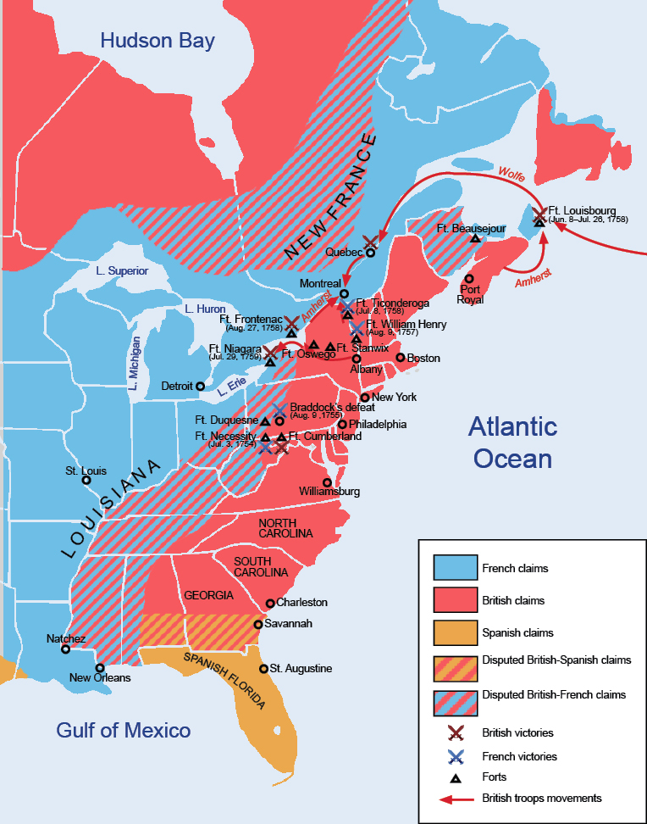
French and Indian War pages 268-272
Began as a competition between Britain and France over the Ohio Valley Region.
The French had many Indian allies.
Ben Franklin tried to unite the colonies in The Albany Congress to defeat the French but they were not willing to work together yet.
For the first 2 years the French and their Indian allies overpowered the British.

Slide 3
CLIP UP QUESTIONS!!!
Who fought in the French and Indian War?
What was the result of the war?
When did the French and Indian War take place?
Where did the war take place?
Why did the war take place?
How did the map of North America change after the war?

Slide 4
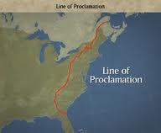
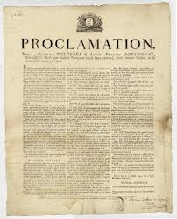
The Proclamation of 1763 pages 273-277
A proclamation is an order from a country’s leader to its citizens.
Wars were breaking out between Native Americans and the colonists. King George III issues a proclamation that forbade colonists from settling west of the Appalachian’s.
Native Americans were happy, but the colonists were furious.

Slide 5
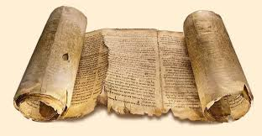
Create a Scroll
Why did King George III issue the Proclamation of 1763?
(King George III issued the Proclamation of 1763 because…)
Why did the proclamation anger the colonists?
(The proclamation angered the colonists because…
Can you think if a compromise that might have satisfied both the king and the colonists?
(King George should have done…)

Slide 6
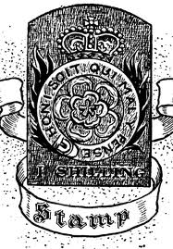
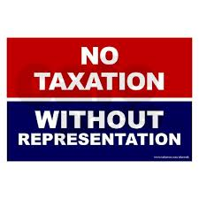
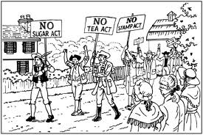
Unfair Taxes pages 280-284 http://www.youtube.com/watch?v=PBBTF0Wg7dY
Winning the French and Indian war cost Britain a lot of money, and they needed a way to pay it back. They did so by imposing taxes on American colonists:
Sugar Act-taxed sugar and other goods
Stamp Act-taxed newspapers, legal documents, playing cards.
Colonists were most angry not because of the taxes, but because they did not have any representation in Britain.

Slide 7
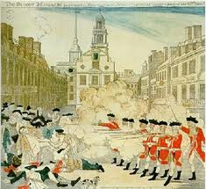
Boston Massacre pages 284-285 http://www.youtube.com/watch?v=PBBTF0Wg7dY
The British Parliament continued to send more troops to the colonies.
The American colonists did not like having British soldiers in the colonies. They would yell and jeer at them and fights would break out often.
One day fighting was very bad and the British fired at the colonists, killing 5 of them.
Crispus Attucks was a colonist who was killed in the Boston Massacre.

Slide 8
Boston Massacre Activities
Time Line Flag: Put the following events of the Boston Massacre in order from what happened first to last.
Chaotic riot, British soldiers fire shots
King George sends 9,000 British troops to the colonies
Five colonists killed by British troops
Colonists taunt, jeer, yell, and throw things at soldiers.
Crispus Attucks Tombstone
Create a tombstone for Crispus Attucks using information you have learned. Be creative and add color! Include:
*Name *Fact about his life *Fact about his death

Slide 9
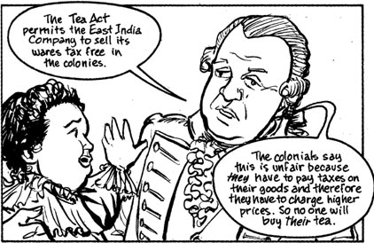
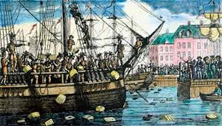
5- The Tea Act 6- The Boston Tea Party 7- The Intolerable Acts pages 288-289 http://www.youtube.com/watch?v=PBBTF0Wg7dY
The British Parliament gave a monopoly on tea to the East India Company.
Colonists boycotted tea.
Sons of Liberty snuck on board and dumped the tea into the harbor.
To punish the colonists, parliament passed many unfair laws that the colonists called intolerable.
Notes:
Read week 13 USA Studies Weekly

Slide 10
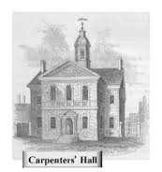
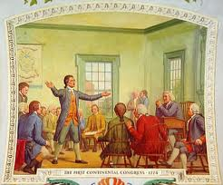
The First Continental Congress page 290
The colonists felt that the British government would do anything to make them obey laws.
Representatives from all the colonies came together at a meeting in Philadelphia to discuss how to respond.
Some wanted to break away from and some wanted to get along with the British government.
The Congress signed a petition that the sent to Britain and stopped trade until they received a response.

Slide 11
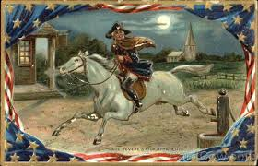
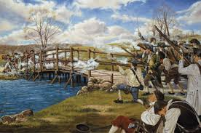
Paul Revere’s Ride to Lexington and Concord http://www.youtube.com/watch?v=rZMmPWTwTHc pages 291-292
The colonists had special militia units made up of Minutemen that defended Massachusettes.
General Thomas Gage of Britain heard that the Minutemen were meeting in Lexington and storing weapons in Concord. He ordered British troops to confiscate the weapons and arrest Hancock and Adams.
Paul Revere learned of this and rode his horse to warn them. This allowed the Minutemen to be prepared to fight and have the chance to hide the weapons.
Notes:
Read Week 14 of Studies Weekly

Slide 12
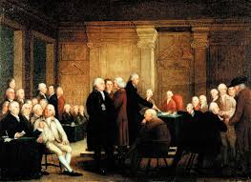
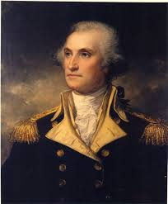
The Second Continental Congress page 293-294
The British government had obviously not responded well to the petition so the Second Continental Congress met.
Some delegates wanted war while others still hoped for peace.
They decided to at least prepare for a war. The Continental Army was lead by General George Washington.

Slide 13
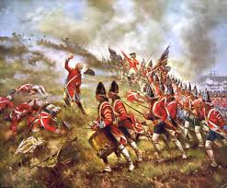
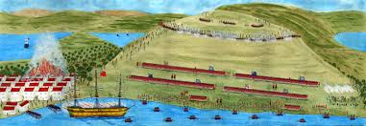
The Battle of Bunker Hill page 294-296
The Battle of Bunker Hill was the first major battle of the Revolutionary War.
It was eventually won by the British but at a great cost. 1,000, or almost half, of the British soldiers were killed while only 350 colonists died.

Slide 14
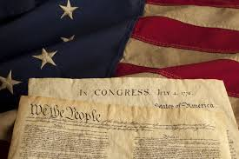
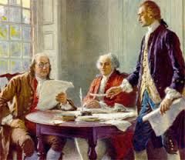
The Declaration of Independence pages 302-307 http://www.youtube.com/watch?v=rZMmPWTwTHc
Some people still wanted to make peace with Britain. That way of thinking changed and more people began to believe in the right for the American colonies to be independent.
Thomas Jefferson wrote the Declaration of Independence that included the preamble, the colonists’ main ideas of government, and their grievances towards the British.
On July 4, 1776 the Congress voted to approve the declaration.

Slide 15
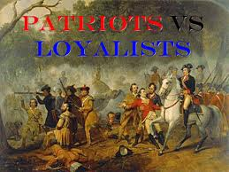
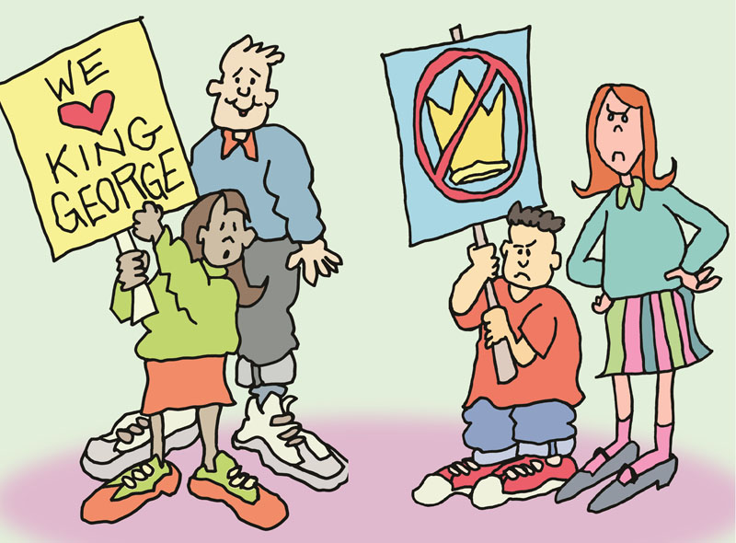
Patriots and Loyalists Chapter 9-2
Colonists had to choose to be patriots or loyalists.
Many African Americans were Patriots and were promised freedom.
Patriot women would take over farms or businesses and some would fight in battle as well. Loyalist women would fight or give the British food and supplies.

Slide 16
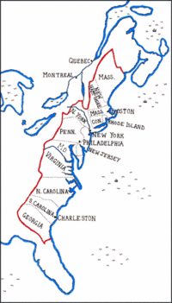
Native Americans and Colonists of the West Chapter 9-2
Native Americans of the West- most stayed out of the fighting however the rest were divided on their loyalties.
Colonists of the West- at first were neutral and didn’t want any kind of government. They did want to drive out the British so they helped out the Patriots without directly supporting their cause.

Slide 17
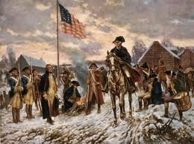
Continental Army Struggles
British had trained and professional soldiers while the Continental Army were very inexperienced.
British outnumbered the colonists but the colonists were passionate about their cause.
British won many of the first battles, but Washington struck on Christmas 1776 in Trenton, New Jersey and in Saratoga, New York.

Slide 18
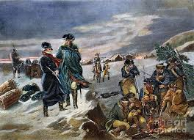
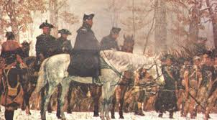
Hard Winter in Valley Forge Chapter 9-3
Soldiers of the Continental Army were almost destroyed by cold and hunger.
They set up headquarters in Valley Forge, Pennsylvania.
Were trained by Freidrich von Steuben and were ready to go in the spring.

Slide 19
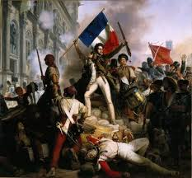
France Helps the Colonists
France wanted to the Americans to win to weaken their British rivals.
France didn’t think the Americans had a chance until they heard of them winning more battles.
The French sent supplies and soldiers to help the Patriots.
Soon, Spain joined and helped the Patriots also.

Slide 20
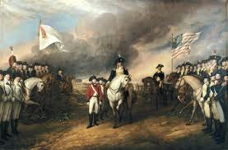
Victory at Yorktown pages 324-326
British were surrounded at Yorktown both on land and sea by the Americans and French.
British General Charles Cornwallis finally surrendered and the Americans were declared victorious.

Slide 21
The Treaty of Paris 326-227
After the Battle of Yorktown representatives of both Britain and America went to Paris and signed a treaty.
The United States of America (page 329) was now officially an independent country!
What Americans wanted: | What the British wanted:
-Britain Parliament to accept their independence and remove British soldiers. | -Loyalists who remained in the United States to be treated fairly.
-British must pay the Americans who property had been destroyed in the war.

